Slide 2
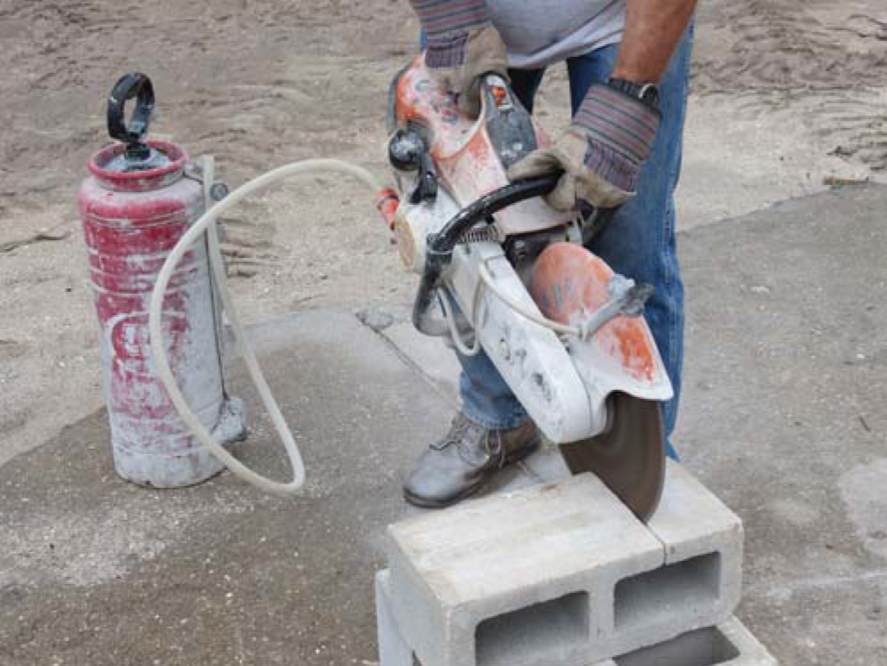
Section 4.1.0
Handheld Masonry Saws
Can be powered by gasoline, electricity, or hydraulics
Blade diameters up to 14 inches
Must use extra caution when using a handheld saw
Notes:
Note: Review safety procedures for using masonry saws if necessary.

Slide 3
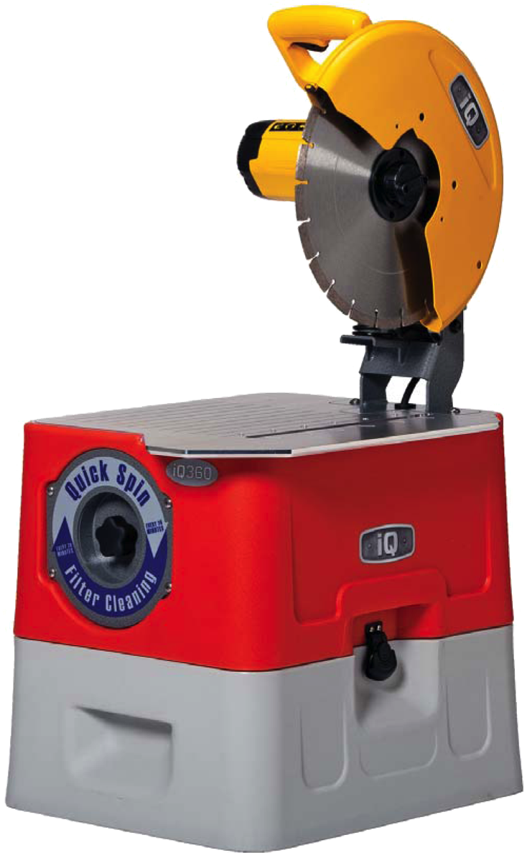
Section 3.3.0
Masonry Saws
Use diamond or Carborundum™ blades
Diamond blades are often irrigated (wet cutting)
Carborundum™ blades are not irrigated (dry cutting)
Notes:
Discuss the differences between diamond and carborundum blades.

Slide 4
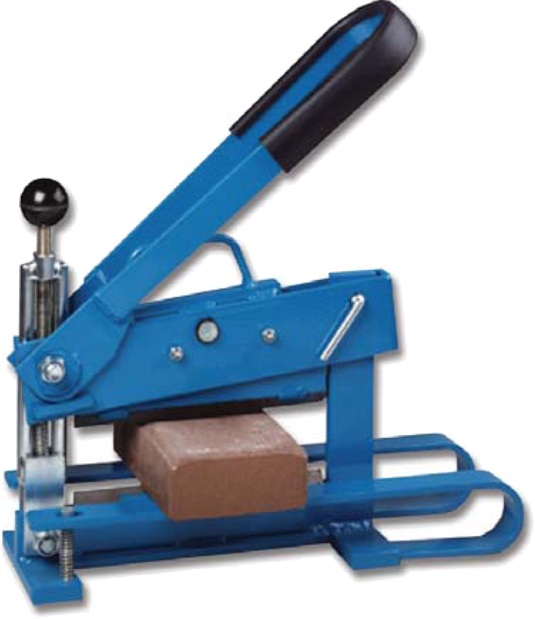
Section 3.3.0
Brick Splitters
Accurate cuts
Do not generate dust

Slide 5
Section 3.4.0
Checking Cut Masonry Units
Know what finished unit should look like
Mark all cutting lines before turning on saw
Mark cutting lines in grease pencil for wet-cut saws
Never cut cracked masonry units

